Slide 1
HUNTING IN THΞ DΔRK
INTRODUCTION TO THREAT INTELLIGENCE AND THREAT HUNTING ON THE DARK WEB

Slide 2
AGENDA
Level-setting
The Process
Resources
Gimme-the-demooo

Slide 3
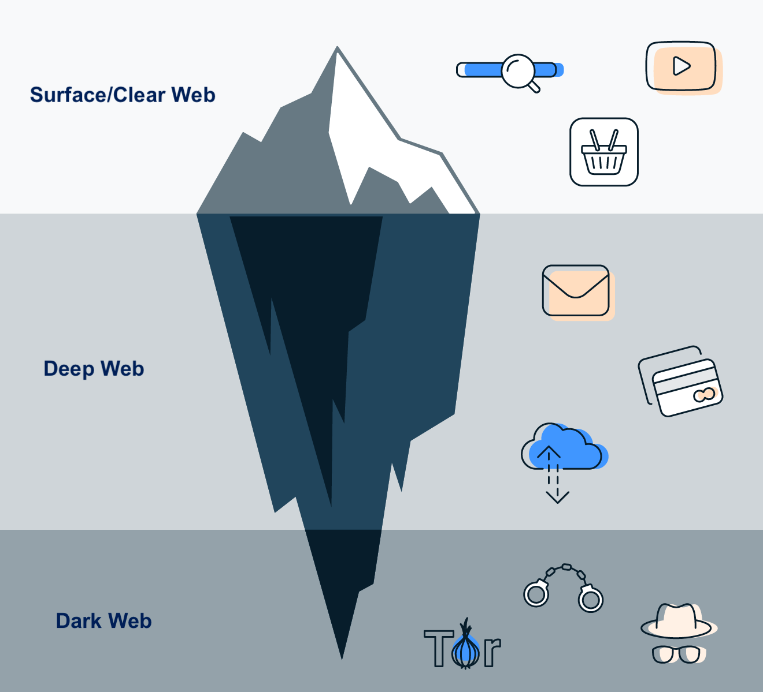
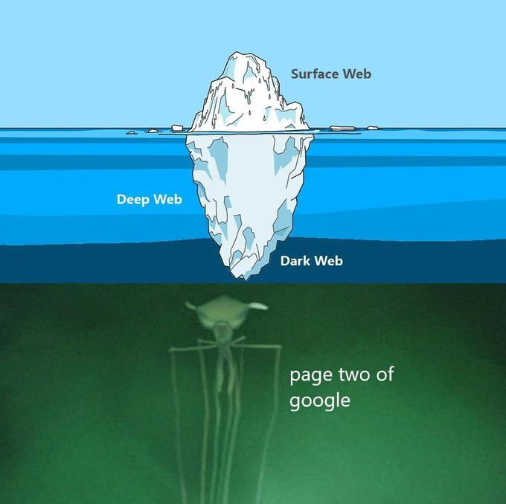
LEVEL-SETTING

Slide 4
THE PROCESS
Find reliable links/resources on the Surface Web
Get on the Dark Web the “right way” (see next slide)
Find forums and marketplaces that you “like”
Do Threat Intel as if you were on the Surface WebC

Slide 5
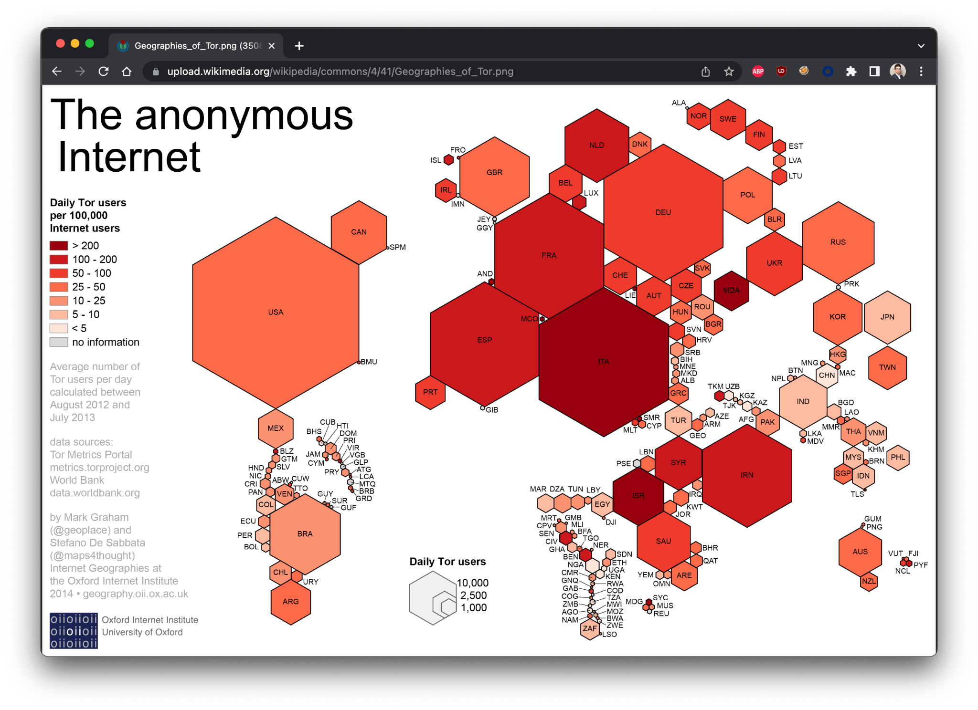
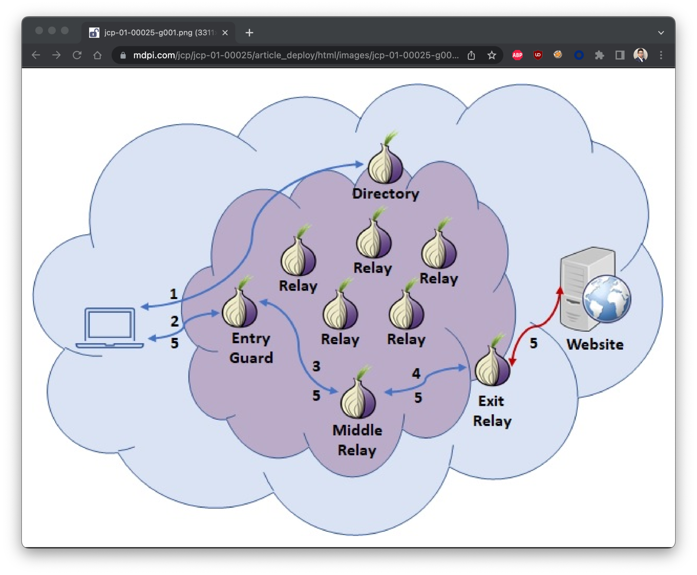
QUICK ON TOR

Slide 6
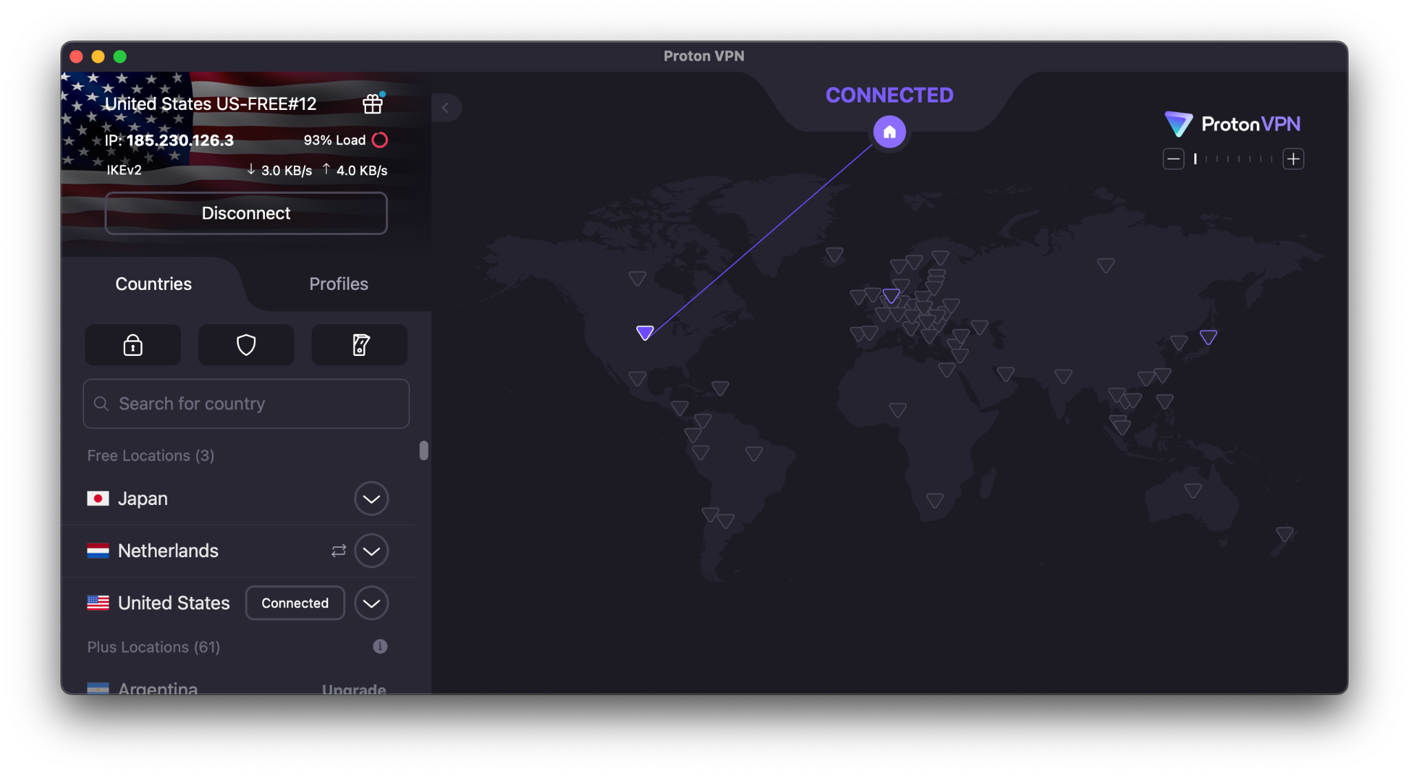
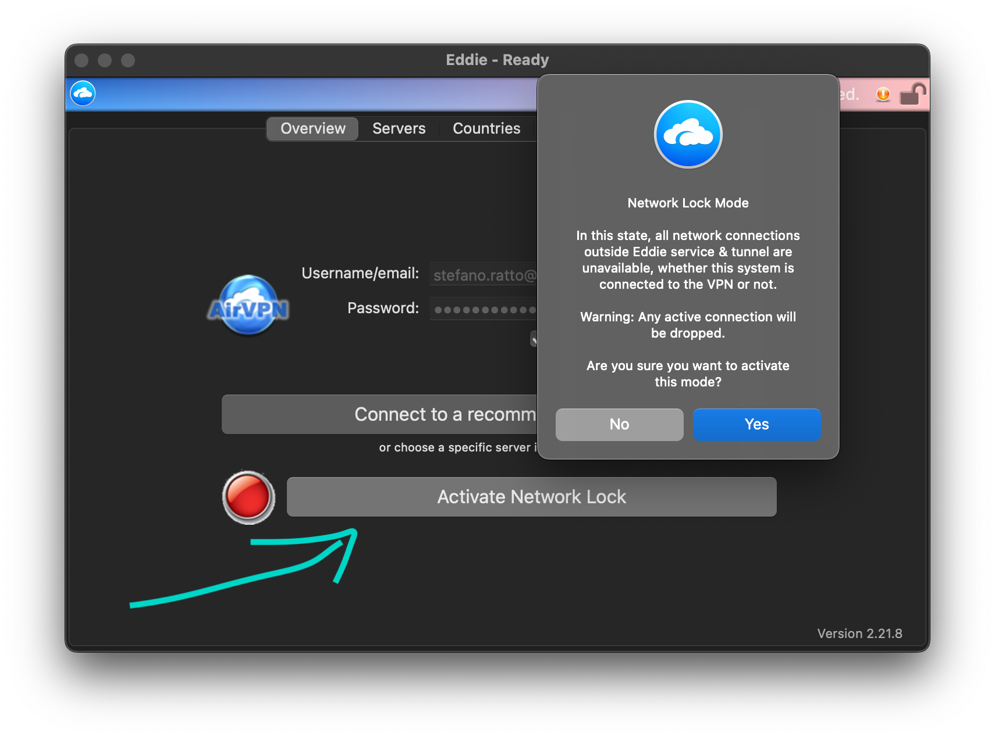
QUICK ON VPNS
Better safe than sorry…
Serious implications
Intention means nothing
Not all VPNs support Tor
ProtonVPN - https://www.protonvpn[.]com
AirVPN - https://www.airvpn[.]org
Network Lock for the W!
Mission Critical
M I S S I O N C R I T I C A L

Slide 7
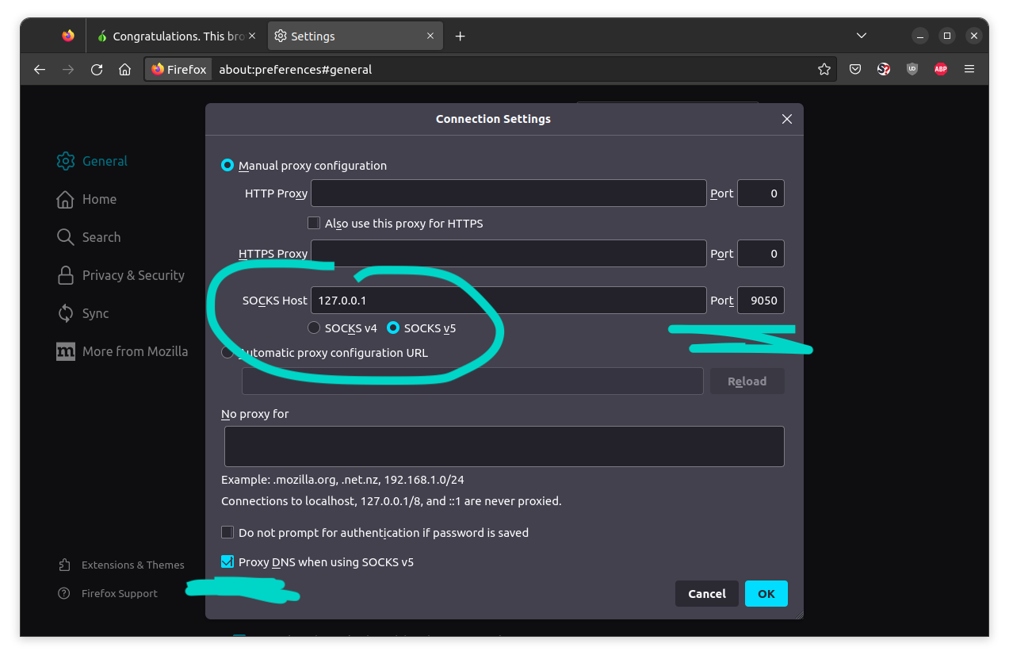
RESOURCES (TOOLS)
Turnkey Browser Setup:
Official Tor Browser - from the Tor Project themselves, Firefox-based
https://www.torproject[.]org/download/
Custom Browser Setup:
Any browser
Install Tor on OS
Disable Javascript
Proxy ALL traffic (including DNS!!)
Entire OS (virtual or physical):
Tails - https://tails.boum[.]org
QubesOS - https://www.qubes-os[.]org
Whonix - https://www.whonix[.]org

Slide 8
RESOURCES (PLACES)
TOR.TAXI:
https://tor[.]taxi
http://tortaxi7axhn2fv4j475a6blv7vwjtpieokolfnojwvkhsnj7sgctkqd[.]onion
DARK.FAIL:
https://dark[.]fail
http://darkfailenbsdla5mal2mxn2uz66od5vtzd5qozslagrfzachha3f3id[.]onion
AHMIA:
https://ahmia[.]fi
http://juhanurmihxlp77nkq76byazcldy2hlmovfu2epvl5ankdibsot4csyd[.]onion
Many, many more…

Slide 9

A QUICK NOTE ON OPSEC
Use VPNs (you should be convinced by now).
Be smart when creating accounts.
Do NOT think in terms of identities/personas.
GPG/PGP ALL. THE. THINGS.
Enjoy the experience!

Slide 10
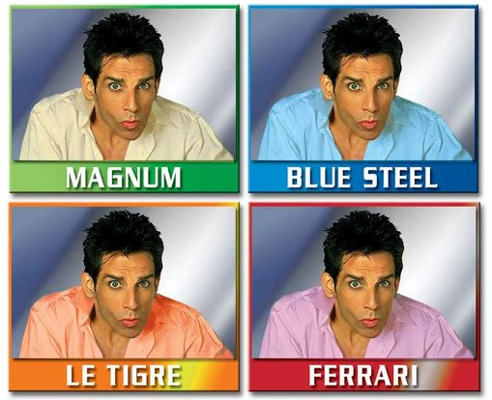
A LITTLE ABOUT ME…
https://www.fakenamegenerator[.]com
https://this-person-does-not-exist[.]com
The sky's the limit

Slide 11

DEMO
Notes:
Own hidden service:
http://3jaymtbdu4zx4x5qjg6ozgz3d6wyx7amubl4u2st7hcgdrxkq3xdirid.onion
Lorenz Blog:
http://lorenzmlwpzgxq736jzseuterytjueszsvznuibanxomlpkyxk6ksoyd.onion
dread Forum:
http://dreadytofatroptsdj6io7l3xptbet6onoyno2yv7jicoxknyazubrad.onion
ASAP Market
http://asap4u7rq4tyakf5gdahmj2c77blwc4noxnsppp5lzlhk7x34x2e22yd.onion
http://asap4u2ihsunfdsumm66pmado3mt3lemdiu3fbx5b7wj5hb3xpgmwkqd.onion
-> DigitalGoods
Hydra Market:
http://hydraclubbioknikokex7njhwuahc2l67lfiz7z36md2jvopda7nchid.onion
CryptBB Forum:
http://cryptbbtg65gibadeeo2awe3j7s6evg7eklserehqr4w4e2bis5tebid.onion
team7/Ambarabaciccicocco1990
Home->Forum or Home->Market
DarkBat Market:
http://5l4azvzhtzzxybvrotdmdh6q2ot47sdncz4uynexwhey2apaxz7abkid.onion

Slide 12



THANK YOU
STEFANO.RATTO@GMAIL.COM
@STEFANO_RATTO
@STEFANORATTO

